Slide 1
This is the Title slide. Please add the course title in the Dummy Course Title section and duration of the course in the Course Duration section.
Please add the graphic description here.
Course Duration 01 hr. 00 mins.
Collaboration and Approval Workflows
D2LS RD Solution
Notes:
Please add the audio note here.

Slide 2
Lifecycle Category

Slide 3
Lifecycle Category
Please add the graphic description here.
D2LS solution provides four levels of document control categories that can be assigned at the artifact level.
Lifecycle Category | Description
Category 1 | Documents within Category 1 receive the highest level of control. Typically these types of documents: Fall under the governance of 21 CRF Part 11 for electronic records Require a Change Request to be in place and approved prior to a new revision of the document being created Require a document control group or quality control group to approve the document in addition to the content approvers An electronic signature is required for all Category 1 documents Require users to read and understand the document before it is made effective Are placed in an “Effective” or “Released” status to indicate they are the current governing document for a particular procedure, work instruction or specification Note: There are no documents in RD and SSV assigned to Category 1 in the OOB LS Solution. This is because these Regulatory documents typically do not require this level of control. However, if the customer would like to govern any documents in RD and/or SSV with this level of control, this change can be made via the D2 Configuration.
Click Play to continue.
© Cognizant 2020 |
Notes:
Please add the audio note here.

Slide 4
Lifecycle Category
Please add the graphic description here.
Lifecycle Category | Description
Category 2 | Documents within Category 2 are controlled documents, in that they require electronic approval for use and revision, but do not require the same level of control as Category 1 documents. Typically these types of documents: Fall under the governance of 21 CRF Part 11 for electronic records Require either an electronic review and approval based on the company’s standard SOPs and business practices Some types of Category 2 documents require an electronic signature page based on predicate rules and/or industry best practices. In other cases, an electronic approval with an accompanying audit trail record is sufficient. Have a final status of “Approved” indicating they are an official electronic record and are ready for use
Category 3 | Documents within Category 3 require an electronic approval, but can be self-approved by either the author or the user who imported the document into the system. Category 3 documents are official electronic records and fall under the governance of 21 CFR Part 11.
Category 4 | Documents assigned to Category 4 are uncontrolled and do not have assigned lifecycle states. Only LS RD includes inventory for Category 4 documents.
Click Play to continue.
© Cognizant 2020 |
Notes:
Please add the audio note here.

Slide 5
Lifecycle Status

Slide 6
Lifecycle Status
Please add the graphic description here.
A document created within the Life Sciences solution has predefined states in which it can be present at any given point of time. These states, as a whole define the lifecycle of the document.
Lifecycles are a very important part of this solution, as security and workflows are directly linked to it.
Status | Description
Draft | Initial state of newly created and imported documents.
For Review | Indicates documents submitted for review to Reviewers.
Reviewed | A document that has completed at least one review cycle.
Formatting Review | The content of the document is complete and the document is undergoing a formatting/QA review.
For Approval | Indicates documents submitted for approval which may result in eSignature page added to the PDF rendition of the document depending on its classification.
Approved | A document that has received all required approvals.
Superseded | Historical versions of official electronic records that have a newer version in effect.
Withdrawn | Historical versions of official electronic records that are no longer in use. Withdrawn is typically synonymous with “Obsolete”.
Suspended | Versions of official electronic records that are temporarily out of use.
Expired | Versions of official electronic records that are past a defined validity date.
Click Play to continue.
© Cognizant 2020 |
Notes:
Please add the audio note here.

Slide 7
Electronic Signature vs Electronic Approval

Slide 8
Electronic Signature vs Electronic Approval
Please add the graphic description here.
D2LS Solutions are pre-configured for which document requires electronic signature and which do not based on industry standards and best practices
Electronic Signature | Electronic Approval
Requires username and password upon approval | Does not require username/password upon approval
Renders an electronic signature page as the first or last page of the PDF rendition | Does not include an electronic signature page in PDF rendition
Includes approval information in audit trail | Includes approval information in audit trail
Click Play to continue.
© Cognizant 2020 |
Notes:
Please add the audio note here.

Slide 9
Workflow Overview

Slide 10
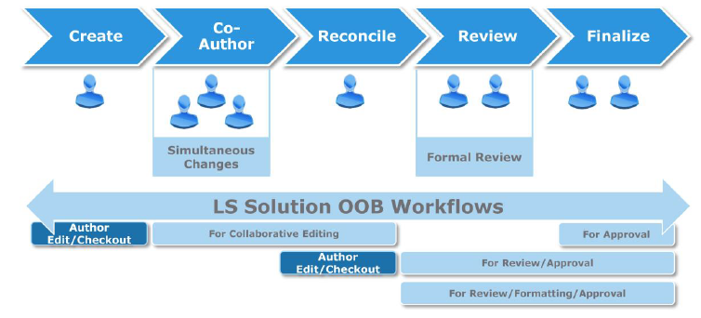
Workflow Overview
Please add the graphic description here.
In D2LS solution, a workflow is a pre-configured serial/parallel review/approval cycle for a document.
A workflow initiator initiates a workflow over a document and selects the reviewers/approvers to participate in the review/approval cycle.
The system sends a task in the Inbox of the workflow participants to complete the review/approval of the document.
The workflow progress for a document can be viewed from the Workflow Overview widget.
Click Play to continue.
© Cognizant 2020 |
Notes:
Please add the audio note here.

Slide 11
Collaborative Editing

Slide 12
Collaborative Editing
Please add the graphic description here.
Allows workflow participants to simultaneously edit a document in its native MS Office Format.
Can be used for co-authoring, (when a document has more than one author) and also for early reviews when the workflow recipients are expected to make substantial edits within the content of the document.
Workflow recipients can edit their personal related copy using MS Office Track changes.
Workflow recipients can see other co-authors/reviewers changes as part of the workflow.
On completion, the workflow initiator can check out the main document in the system, merge all the workflow recipients’ changes into the checked out version, and check the document in as a new version.
Initiation and completion of this workflow does not change the lifecycle status of the document i.e. Draft.
Menu Command in LS Solution: “Submit for Collaborative Editing”
User Task | Description
Edit document | Reviewers review and edit the document.
Incorporate changes | Authors incorporate the changes from each Reviewer.
Click Play to continue.
© Cognizant 2020 |
Notes:
Please add the audio note here.

Slide 13
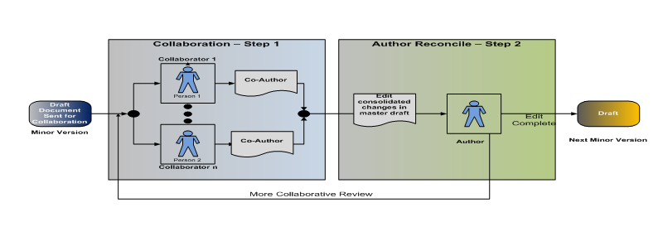
Collaborative Editing Cont.
Please add the graphic description here.
Click Play to continue.
© Cognizant 2020 |
Notes:
Please add the audio note here.

Slide 14
Approval Workflow

Slide 15
Document Approval Workflow
Please add the graphic description here.
Review and Approval Workflow
Review–Format Approval Workflow
Approval Only Workflow
Click Play to continue.
© Cognizant 2020 |
Notes:
Please add the audio note here.

Slide 16
Review and Approval Workflow
Please add the graphic description here.
To obtain an electronic approval or an electronic signature on a document(s) and include a formal review step prior to the document(s) being sent to the approvers.
Allows Document Collaboration.
Allows the document(s) to be sent directly to the Approval Step if the Review Step has been completed successfully (that is, no comments or changes) or if an electronic review in the system is not required.
Upon successful completion of this workflow, the document is promoted to a new major version and becomes an official electronic record.
If an electronic signature is required, the system will render an electronic signature page on the PDF Rendition of the document, and include the approvers’ information (Name, Signature Intention, and Date of Signature) on the signature page.
Approver’s approvals are included on the electronic signature page. Approver’s rejections are captured in the Audit Trail Report but not on the electronic signature page.
All review and approval outcomes are captured in the Audit Trail.
Menu Command in LS Solution: “Submit for Review and Approval”
Click Play to continue.
© Cognizant 2020 |
Notes:
Please add the audio note here.

Slide 17
Review and Approval Workflow Cont.
Please add the graphic description here.
User Task | Description
Draft | Authors review the feedback on the document. After the Approver demotes the document to Draft, the Author can skip the review task after making the changes and send the document directly for approval.
Draft – Do not allow skip | Authors review the feedback on the document and resend the edited draft document for another round of review. Authors cannot skip the review of the document.
Review | Reviewers review the content.
Approval | Approvers approve the document. The document must be electronically signed on approval.
Approval-no Sig | Approvers approve the document. Electronic signature is not required on approval.
Correct Invalid Approvers | The system validates the list of participants assigned as Approvers of the document and checks if the workflow initiator is assigned as the sole participant in these roles. If so, the document is rejected back to the workflow initiator who must correct the invalid list of Approvers.
Document has been issued | After the review and approval tasks are complete, the Author receives a notification to set the review dates.
Click Play to continue.
© Cognizant 2020 |
Notes:
Please add the audio note here.

Slide 18
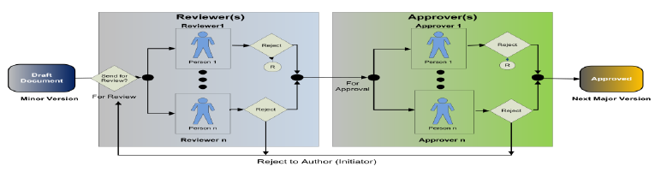
Review and Approval Workflow Cont.
Please add the graphic description here.
Click Play to continue.
© Cognizant 2020 |
Notes:
Please add the audio note here.

Slide 19
Review-Format Approval Workflow
Please add the graphic description here.
To obtain an electronic approval or an electronic signature on a document(s).
The workflow also includes a formal content review step and a “formatting” step.
The purpose of the formatting step is for a designated user to perform a word processing format review and “clean up” on the document(s).
This step is typically required for larger documents with several sections and tables, such as Study Protocols, Reports, and Summaries.
This step provides a designated task for users to ensure that the document(s) is following the proper ICH format guidelines (i.e. Arial font, etc.), TOCs/bookmarks/hyperlinks have been added correctly, and that the document is “submission ready”.
All review and approval outcomes are captured in the Audit Trail.
Menu Command in LS Solution: “Submit for Review-Format Approval”
Click Play to continue.
© Cognizant 2020 |
Notes:
Please add the audio note here.

Slide 20
Review-Format Approval Workflow Cont.
Please add the graphic description here.
User Task | Description
Draft | Authors review the feedback on the document. After the Format Reviewer demotes the document to Draft, the Author can send the document to the Reviewer, Format Reviewer or Approver. After the Approver demotes the document to Draft, the Author can skip the review task after making the changes and send the document directly for approval.
Draft – Do not allow skip | Authors review the feedback on the document and resend the edited draft document for another round of review. Authors cannot skip the review of the document.
Review | Reviewers review the content.
Format Review | Format reviewers review the content.
Approval | Approvers approve the document. The document must be electronically signed on approval.
Approval-no Sig | Approvers approve the document. Electronic signature is not required on approval.
Correct Invalid Approvers | The system validates the list of participants assigned as Approvers of the document and checks if the workflow initiator is assigned as the sole participant in these roles. If so, the document is rejected back to the workflow initiator who must correct the invalid list of Approvers.
Click Play to continue.
© Cognizant 2020 |
Notes:
Please add the audio note here.

Slide 21
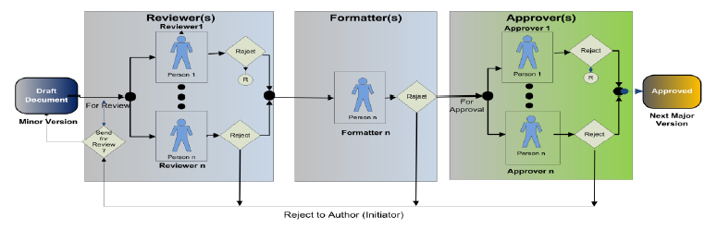
Review-Format Approval Workflow Cont.
Please add the graphic description here.
Click Play to continue.
© Cognizant 2020 |
Notes:
Please add the audio note here.

Slide 22
Approval Only Workflow
Please add the graphic description here.
To obtain an electronic approval or an electronic signature on a document when a formal review step is not necessary or has already been completed.
Upon successful completion of this workflow, the document is promoted to a new major version and becomes an official electronic record.
If an electronic signature is required, the system will render an electronic signature page on the PDF Rendition of the document, and include the approvers’ information (Name, Signature Intention, and Date of Signature) on the signature page.
Approver’s approvals are included on the electronic signature page. Approver’s rejections are captured in the Audit Trail Report but not on the electronic signature page.
All approval outcomes are captured in the Audit Trail.
Menu Command in LS Solution: “Submit for Approval”
Click Play to continue.
© Cognizant 2020 |
Notes:
Please add the audio note here.

Slide 23
Approval Only Workflow Cont.
Please add the graphic description here.
User Task | Description
Approval | Approvers approve the document. The document must be electronically signed on approval.
Approval-no Sig | Approvers approve the document. Electronic signature is not required on approval.
Correct Invalid Approvers | The system validates the list of participants assigned as Approvers of the document and checks if the workflow initiator is assigned as the sole participant in these roles. If so, the document is rejected back to the workflow initiator who must correct the invalid list of Approvers.
Draft | Authors review the feedback on the document.
Document has been issued | After the approval tasks are complete, the Author receives a notification to set the review dates.
Click Play to continue.
© Cognizant 2020 |
Notes:
Please add the audio note here.

Slide 24
Approval Only Workflow Cont.
Please add the graphic description here.
Click Play to continue.
© Cognizant 2020 |
Notes:
Please add the audio note here.

Slide 25
Lifecycle Status Transition

Slide 26
Lifecycle Status Transition
Please add the graphic description here.
The following figure illustrates the lifecycle state transitions in the Control Category 2 Documents Lifecycle Model:
Click Play to continue.
© Cognizant 2020 |
Notes:
Please add the audio note here.

Slide 27
Lifecycle Status Transition Cont.
Please add the graphic description here.
The following figure illustrates the lifecycle state transitions in the Control Category 3 Documents Lifecycle Model:
Click Play to continue.
© Cognizant 2020 |
Notes:
Please add the audio note here.

Slide 28
References
Please add the graphic description here.
Documentum_for_Life_Sciences_16.4_Administration_Guide
Documentum for Research and Development 16.4 Configuration Requirements Specification
Click Play to continue.
© Cognizant 2020 |
Notes:
Please add the audio note here.

Slide 29
This is the Thank You slide.
Please add the graphic description here.
Thank You
Click the browser close button to exit the course.
Notes:
Please add the audio note here.

